Slide 1

SQL Part 2: sql fundamentals

Slide 2
fundamentals of sql
SQL stands for Structured Query Language
All SQL databases are relational databases, but not all databases use SQL or are relational

Slide 3
crud
CRUD stands for Create, Read, Update, and Delete
CRUD actions are those which only affects records (or rows)
We can use SQL to accomplish all the CRUD actions

Slide 4
sql commands
CREATE – used to develop a new table, table view, or any other database object
ALTER – used to modify any database object
DROP – used to delete any database component like the table, column value, or any other object
SELECT – used to highlight any row from the table
INSERT– used to create a row
UPDATE – used to modify or alter the rows (records)
DELETE – used to delete rows
GRANT – used to provide a user with certain privileges
REVOKE – used to take back user privileges

Slide 5
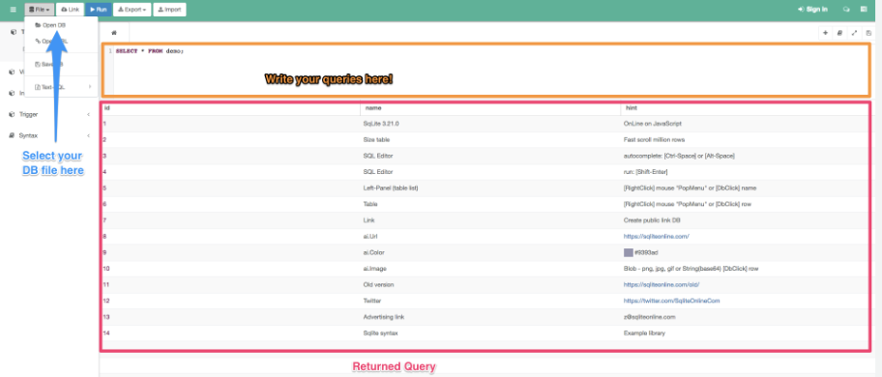
practice: open your database
Open sqliteonline.com and upload the songs database, “my_ipod.sqlite3”

Slide 6
sql command: create
In SQL, we create tables using CREATE
Let’s begin by creating 2 tables:
CREATE TABLE User
(
UserID INTEGER PRIMARY KEY AUTOINCREMENT NOT NULL,
FirstName VARCHAR NOT NULL,
LastName VARCHAR NOT NULL,
BirthPlace VARCHAR NOT NULL,
CreatedAt DATETIME NOT NULL,
UpdatedAt DATETIME NOT NULL
);

Slide 7
sql command: create
CREATE TABLE Favorite
(
FavoriteID INTEGER PRIMARY KEY AUTOINCREMENT NOT NULL,
UserID INTEGER NOT NULL,
ArtistID INTEGER NOT NULL,
AlbumID INTEGER NOT NULL,
SongID INTEGER NOT NULL,
GenreID INTEGER NOT NULL,
CreatedAt DATETIME NOT NULL,
UpdatedAt DATETIME NULL,
FOREIGN KEY (UserID) REFERENCES User (UserID),
FOREIGN KEY (ArtistID) REFERENCES artists (id),
FOREIGN KEY (AlbumID) REFERENCES albums (id),
FOREIGN KEY (SongID) REFERENCES songs (id),
FOREIGN KEY (GenreID) REFERENCES genres (id)
);

Slide 8
SQL command: insert
INSERT adds a row (or record) into an existing table
Syntax:
INSERT INTO TABLE_NAME(column1, column2, …) VALUES (value1, value2, …)
INSERT INTO User
(
FirstName,
LastName,
BirthPlace,
CreatedAt
)
VALUES
(
‘Wesley’,
‘Chambers’,
‘Orlando, Florida’,
CURRENT_DATE
);
INSERT INTO User
(
FirstName,
LastName,
BirthPlace,
CreatedAt
)
VALUES
(
‘Michael’,
‘Jordan’,
‘Brooklyn, New York’,
CURRENT_TIMESTAMP
);

Slide 9
sql command: SELECT
SELECT “reads” tables and returns every record which satisfies the statement
Syntax:
SELECT column1, column2 FROM table_name
SELECT everything from a table:
SELECT one column from a table:
SELECT * FROM artists; --selecting all columns and all rows
SELECT name FROM songs; --selecting one columns and all rows

Slide 10
sql command: SELECT
SELECT some but not all columns from a table:
As you can see, a bare select statement will return all rows for whatever columns are selected
However, we can limit rows as well with the help of a WHERE clause:
SELECT
id,
name,
created_at
FROM songs;
SELECT * FROM songs WHERE length > ‘5:00’;
--selecting only rows with songs that are longer than 5 minutes
--the time is in single tick marks because that column is VARCHAR

Slide 11
sql command: SELECT
SELECT records whose LastName matches a value within a set of values:
More operators we can use (AND/OR/LIKE/IS):
SELECT * FROM User WHERE LastName IN (‘Jordan’,’Brown’,’Ashley’,’Carnegie’);
SELECT * FROM User WHERE FirstName = ‘Wesley’ AND LastName = ‘Chambers’;
SELECT * FROM User WHERE FirstName = ‘Wesley’ OR LastName = ‘Jordan’;
SELECT * FROM User WHERE UserID > 1 OR
(UpdatedAt IS NULL AND FirstName = ‘Florence’);
SELECT * FROM User WHERE FirstName LIKE ‘%ley’;
SELECT * FROM User WHERE FirstName LIKE ‘%esl%’;
SELECT * FROM User WHERE FirstName LIKE ‘%sle%’ OR LastName LIKE ‘Jor%’;
SELECT * FROM User WHERE FirstName LIKE ‘_esley’;

Slide 12
SQL LOGICAL OPERATORS
The operators shown on the last slide are some of SQL’s logical operators
Many of these should be familiar from the programming we’ve already done, but some are slightly different:
ALL: TRUE if all the subquery values meet the condition
AND: TRUE if all the conditions separated by AND are TRUE
ANY: TRUE is any of the subquery values meet the condition
BETWEEN: TRUE if the operand is within the range of the comparisons
IN: TRUE if the operand is equal to one of a list of expressions
NOT: displays a record if the condition(s) is NOT TRUE
OR: TRUE if any of the conditions separated by OR are TRUE
EXISTS: TRUE if the subquery returns one or more records
LIKE: TRUE if the operand matches a pattern

Slide 13
SQL LOGICAL OPERATORS
BETWEEN/AND is inclusive:
If we wanted to return 1-6 exclusive:
SELECT * FROM artists WHERE id BETWEEN 1 and 6; --will return 1-6 inclusive
SELECT * FROM artists WHERE id > 1 AND id < 6;

Slide 14
SQL comparison OPERATORS
SQL also has comparison operators, as we’ve started to notice:
= : evaluates equivalency
!= : displays a record if the condition(s) is NOT TRUE
<> : not equal
< : less than
> : greater than
<= : less than or equal to
>= : greater than or equal to
!< : not less than
!> : not greater than
Comparison operators return TRUE or FALSE, so long as the items compared are not NULL

Slide 15
sql comparison operators
IS and IS NOT return TRUE or FALSE even if one or both operands are NULL
If both are NULL, IS returns 1 (TRUE) and IS NOT returns 0 (FALSE)
If one operand is NULL and the other is not, IS returns 0 (FALSE) and IS NOT returns 1 (TRUE)
IS and IS NOT never return NULL, while =, !=, and <> sometimes do

Slide 16
Summary
The columns you want to return are what follows SELECT
If you want all the columns, use SELECT *
Rows can be filtered with WHERE
Theoretically, you can select just about anything

Slide 17
sql command: update
With UPDATE, we are not creating, but rather changing one or more rows
Syntax: UPDATE table_name SET column1 = value1 WHERE condition
UPDATE one column for one row:
UPDATE multiple columns for one row:
UPDATE artists SET name = ‘Janet Jackson’ WHERE name LIKE ‘janet Jackson’;
UPDATE User
SET FirstName = ‘Wesley A.’
LastName = ‘Chambers IV’
UpdatedAt = CURRENT_TIMESTAMP
WHERE UserID = 1;

Slide 18
sql command: update
Before we discuss changing multiple rows, which can have a lot of drastic consequences, let’s look at a trick
Details aside, queries or statements in SQL are called transactions
If you want to see what a transaction will do without doing it, you can put it within a TRANSACTION window and roll it back
BEGIN TRANSACTION;
UPDATE User SET FirstName = ‘Hey, change my name back!’;
SELECT * FROM User;
ROLLBACK;

Slide 19
sql command: update
If you execute SELECT * FROM User outside the transaction, you will see that all is normal
Thankfully, since you rolled back the transaction, nothing changed
This is a good thing to do when UPDATING or DELETING, since it is easy to make a mistake

Slide 20
sql command: delete
DELETE permanently deletes one or more rows from a table
Syntax: DELETE FROM table_name WHERE condition
We don’t want to delete anything right now, so we’ll wrap the statement in a rollback transaction
BEGIN TRANSACTION;
DELETE FROM User;
SELECT * FROM User;
--this is here to help us see what would have happened after our DELETE
--we don’t need this in order to DELETE
ROLLBACK;

Slide 21
sql command: delete
Since the SELECT was executed before the DELETE was rolled back, nothing returned
If you SELECT outside of the transaction window, we see that nothing was changed
DELETE specific rows:
BEGIN TRANSACTION;
DELETE FROM songs WHERE id BETWEEN 5 AND 10;
SELECT * FROM songs WHERE id < 11;
--records 5-10 would have been deleted if the rollback did not happen
ROLLBACK;

